Slide 1
【iSpring Suite Sharing】 孫殷同 2011 July 20
機械系
Department of Mechanical Engineering

Slide 2
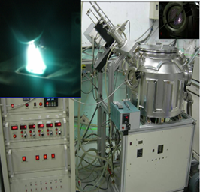
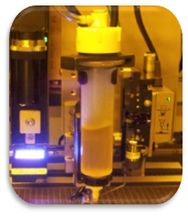
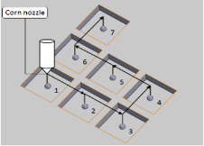
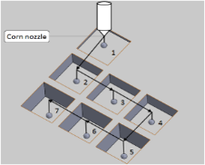
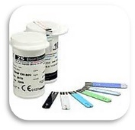
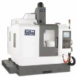
製造科技研究所 Institute of Manufacturing (Mfg.) Technology
研究領域
近期研究主題
由先進製程導入元件/解決方案，整合智能製造，落實自動化的充分要素，營建精實價創平台
物聯網工程科技多能工培訓
類產線工程教育創新
製造科學先進製程實務型研究
精實生產系統持續改善
製造管理方法實務型研究
機電整合實務型研究
電腦輔助模擬與模擬器應用
製造管理與精實生產系統
Mfg. Management and Lean Production Systems
人造鑽石薄膜製程
Processes of Diamond Films Fabrication
先進製程-智慧製造自動化-實驗室
Advanced Processes and Intelligent Manufacturing Automation Group (APIMAG)
Research Area
Recent Topics
Total solution or device development for advanced processes, integrated intelligent manufacturing, automation as sufficient factors, value-added production platform
Web and Internet of Things (WIoT)- based multiple skills training
Realistic production lines engineering education innovation
Production flow control
Lean production for continuous improvement
Advanced processes interdisciplinary research
Mechatronics application research
Computer aided simulation and simulator integrated applications
科技部計畫:網宇實體系統應用於血醣酵素試片製程路徑規劃最佳化發展Government-funded Project: Cyber Physical System (CPS)-based Simulation on Enzyme Test Strip Fabrication
O: 綜科 228
#2068
L: 綜科 B1-1
#2050
孫殷同 副教授
Associate Prof. Yin Tung Albert Sun
美國辛辛那提大學
University of Cincinnati
ytsun@ntut.edu.tw
apimag-moodle.me.ntut.edu.tw
產學處計畫: 物聯網工程科技多能工培訓
Academia-Industry Alliance Project:
WIoT-based Multiple Skills Training

Slide 3
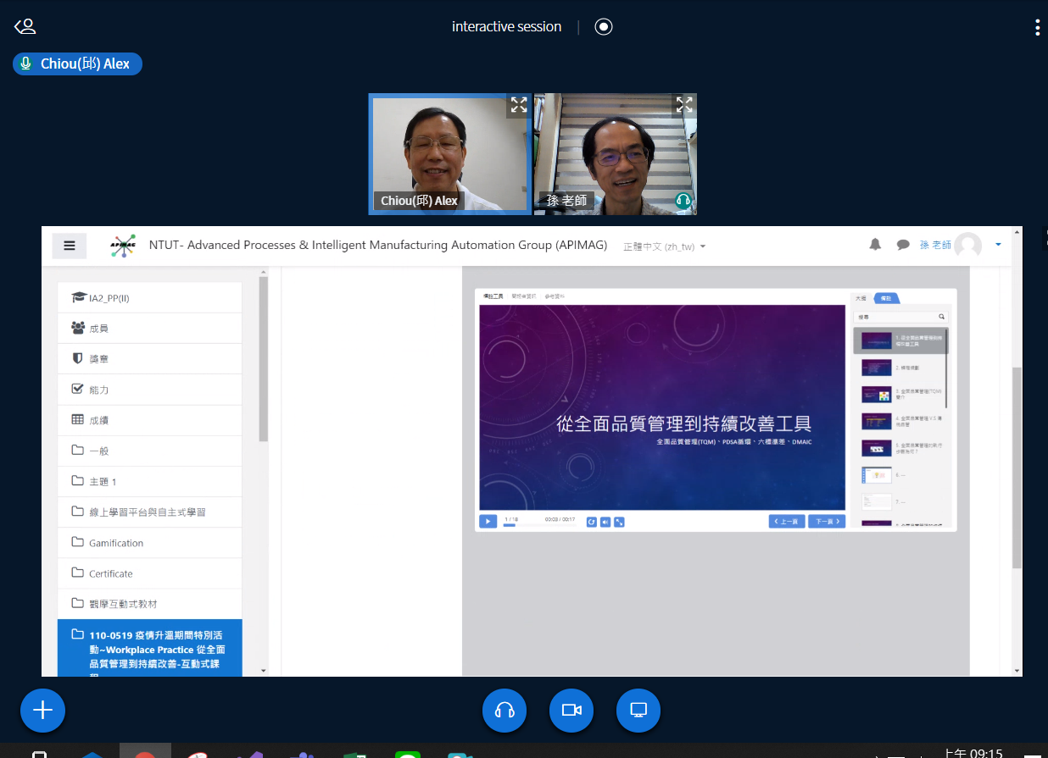

Slide 4
感謝聆聽 敬請指教

