Slide 1
Vyond, Animation and beyond
Chun-Hao Chang
chunhao@gm.ntunhs.edu.tw

Slide 2
Agenda
Why Animation ?
Why Vyond?
Closing thoughts.

Slide 3
Why Animation ?
01

Slide 4
Why Animation?
The sudden outbreak of COVID-19 in Taiwan
Level 3 pandemic alert ⬄ developing self-awareness of well-being
Health literacy for everyone, everyday
COVID 19 : a blessing in disguise ?

Slide 5
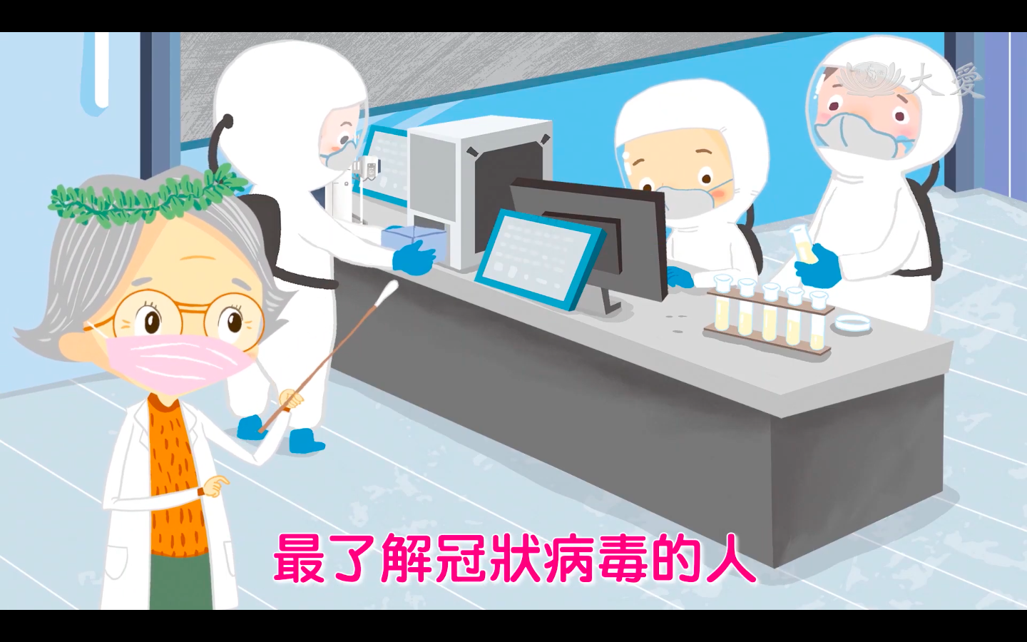
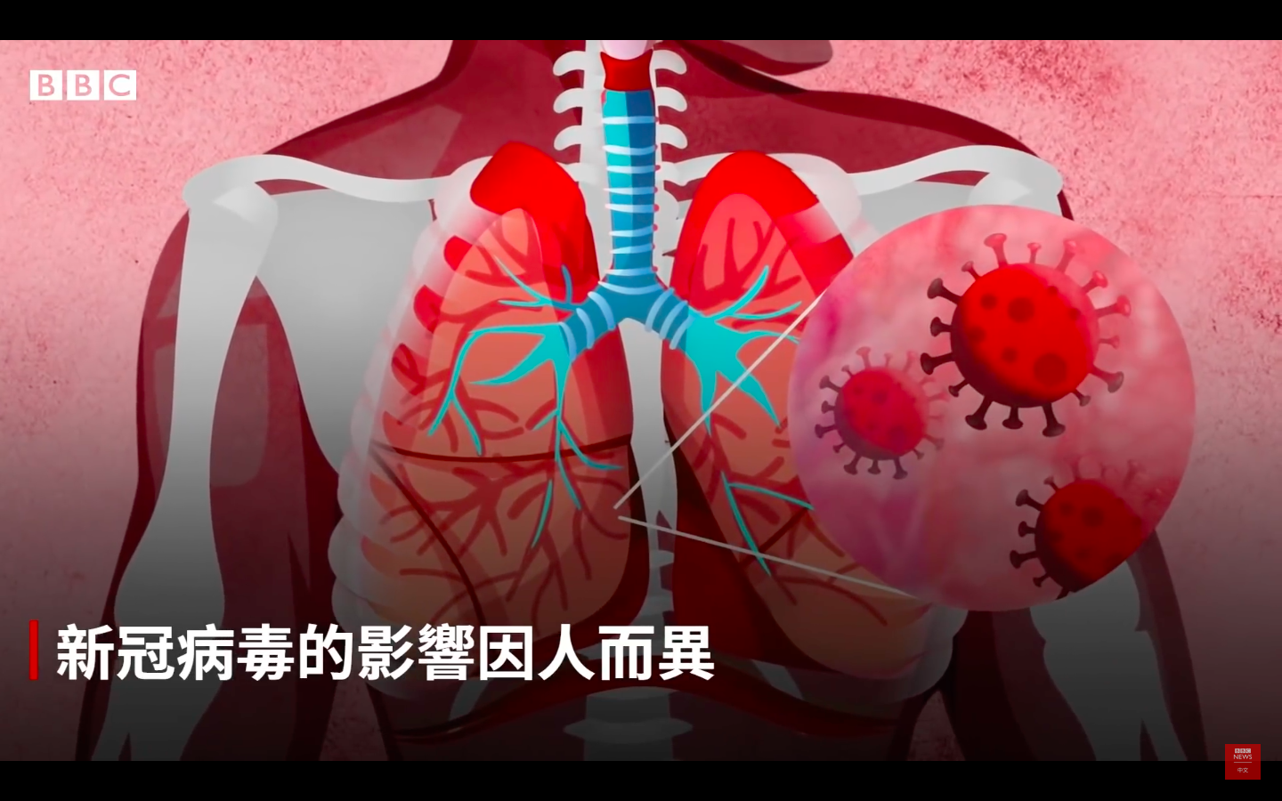
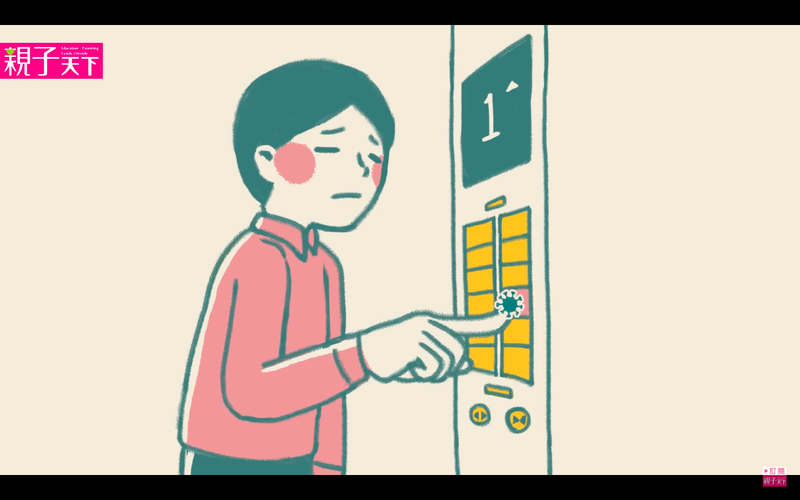
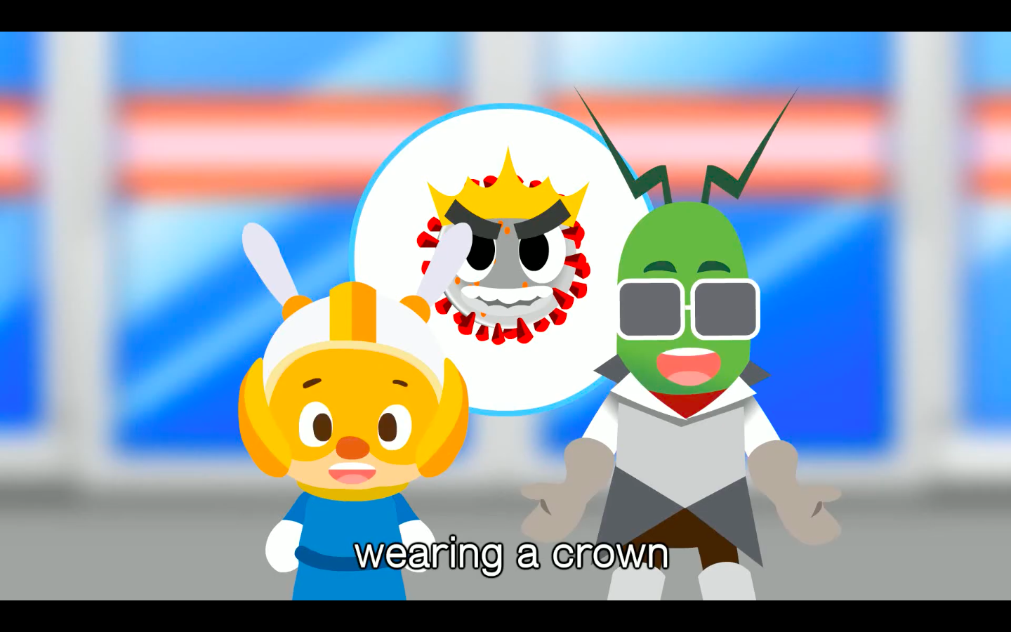

Slide 6
Why Animation?
Situated and highly interactive
Rich in story contexts
Illustrate complex, abstract learning concepts.
Generation Y&Z’s go-to for learning.
Long-lasting memory

Slide 7
02
Why Vyond ?

Slide 8
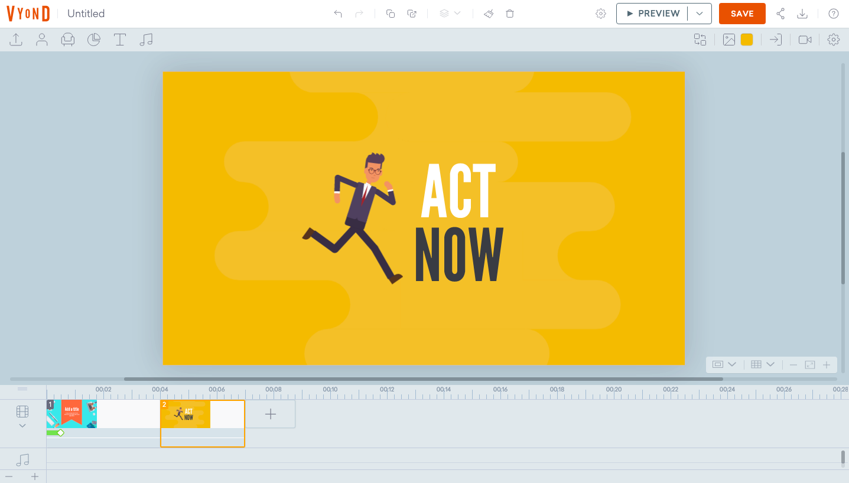
Why Vyond
Personal experiences
Friendly user interface + abundant templates + prompt supports
Stable and reliable
a short learning curve
Positive user feedback

Slide 9
Why Vyond
Pick a theme
Design your characters
Put together text and pictures
Arrange visual effect
Add voices
Ready to go!

Slide 10
Vyond Showcasing

Slide 11
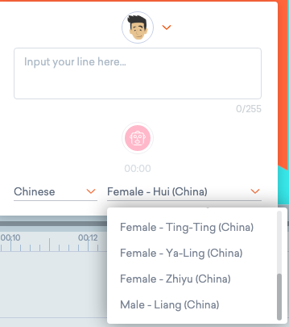
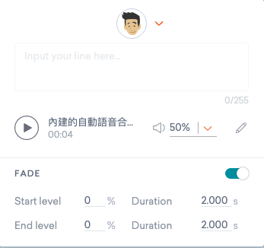
Why Vyond
Built-in text-to-speech

Slide 12
Vyond Text-to-Speech

Slide 13
Why Vyond
Text-to-speech API comparisons
 | Vyond | Azure | Google
Languages | 30 | above 40 | above 40
Customizable voice (speed/pitch) | No | Yes | Yes
Speaking style (customer service, chat…etc) | No | Yes | No
Taiwanese accent | No | Yes | Yes

Slide 14
Closing thoughts
03

Slide 15
Animation is for everyone
Interactive stoytelling/explainer videos in the classroom
A literacy skill for everyone to acquire.
Vyond is a great start point.

Slide 16
THANK YOU
chunhao@gm.ntunhs.edu.tw

